Slide 1



Evaluating Classification Models
This presentation will explore the importance of model evaluation and cover key techniques like cross-validation and hold-out validation. Properly evaluating a classification model is crucial to ensuring its effectiveness and real-world performance.
by Dr. Mahammad Shabana

Slide 2
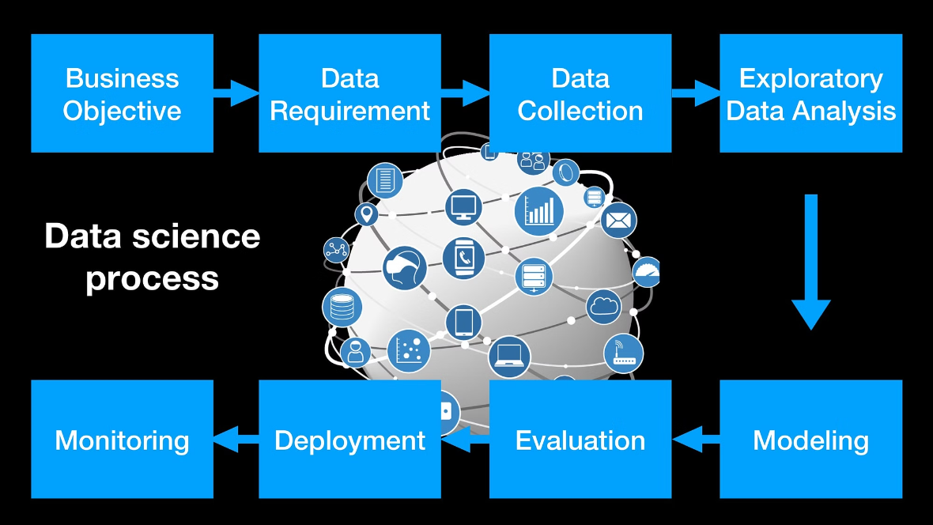

Slide 3
Importance of Model Evaluation
1
Avoid Overfitting
2
Estimate Generalization
3
Improve Model Selection
Evaluating model performance on unseen data helps detect and prevent overfitting to the training data.
Proper evaluation techniques give a realistic estimate of how well the model will perform on new, real-world data.
Evaluation metrics guide the selection of the best-performing model for deployment.

Slide 4
Train-Test Split
Training Set
Test Set
Ratio
Used to train the model. Should be representative of real-world data.
Held-out data used to evaluate the model's performance. Must be independent of the training data.
Common ratios are 80/20 or 70/30 for train/test splits.

Slide 5
Cross-Validation
1
Fold Data
Split the dataset into k equal-sized folds.
2
Train on k-1
Train the model on k-1 folds, holding out one for validation.
3
Evaluate on Holdout
Evaluate the model's performance on the holdout fold.

Slide 6
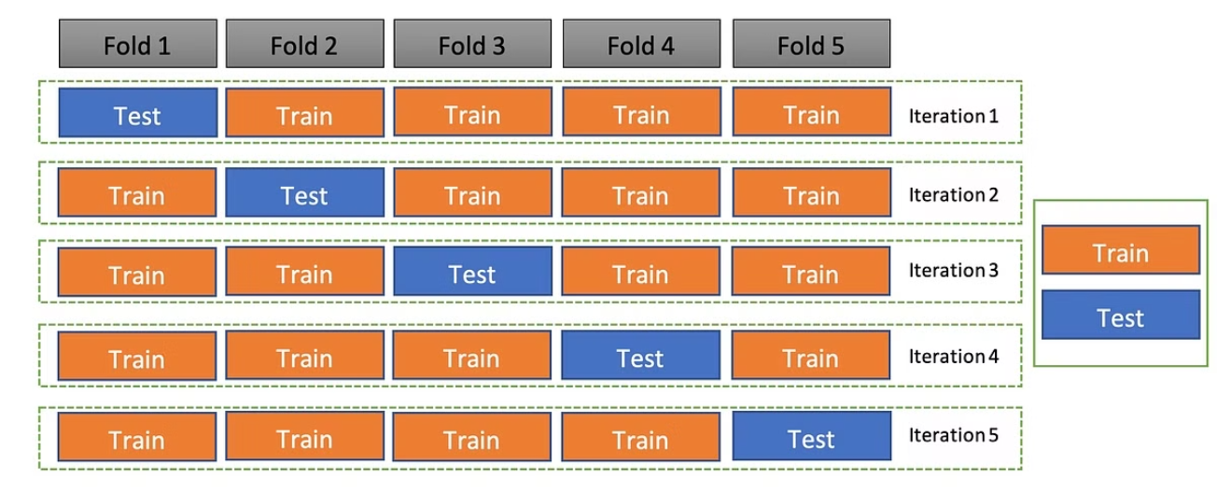

Slide 7
Stratified Cross-Validation
Balanced Folds
Handles Imbalanced Data
Ensures the class distribution in each fold mirrors the overall dataset.
Stratification is especially important when working with imbalanced classification problems.
Reliable Evaluation
Common Implementation
Provides a more accurate estimate of model performance on new, unseen data.
scikit-learn's StratifiedKFold is a popular way to implement stratified cross-validation.

Slide 8



Hold-Out Validation
Training Set
Use the majority of the data to train the model.
Validation Set
Hold out a portion of the data to evaluate the model.
Test Set
Use a final, completely separate test set to get an unbiased estimate of performance.

Slide 9
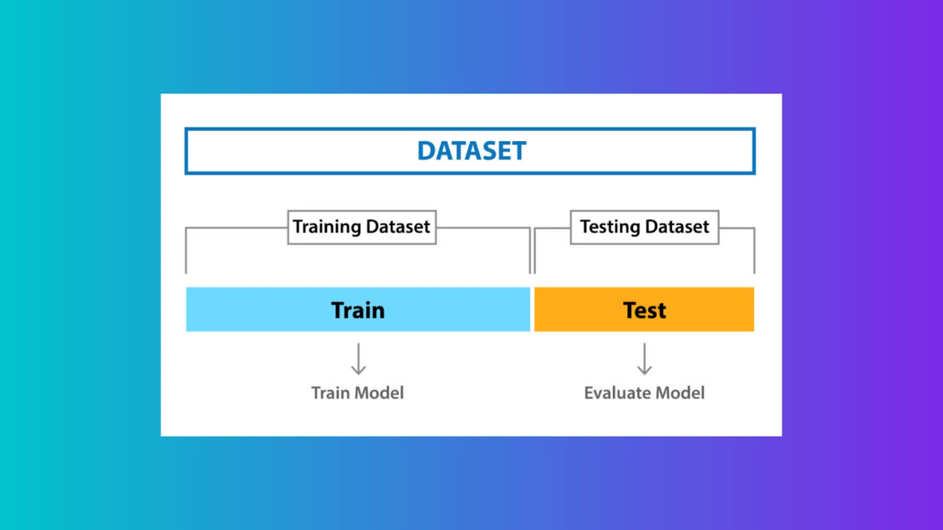

Slide 10




Choosing the Right Evaluation Method
Cross-Validation
Hold-Out
Stratification
Considerations
Robust evaluation for limited data, good for model selection.
Provides a final, unbiased estimate of real-world performance.
Important for imbalanced datasets to ensure representative folds.
Dataset size, class balance, and model complexity should guide the choice.

Slide 11
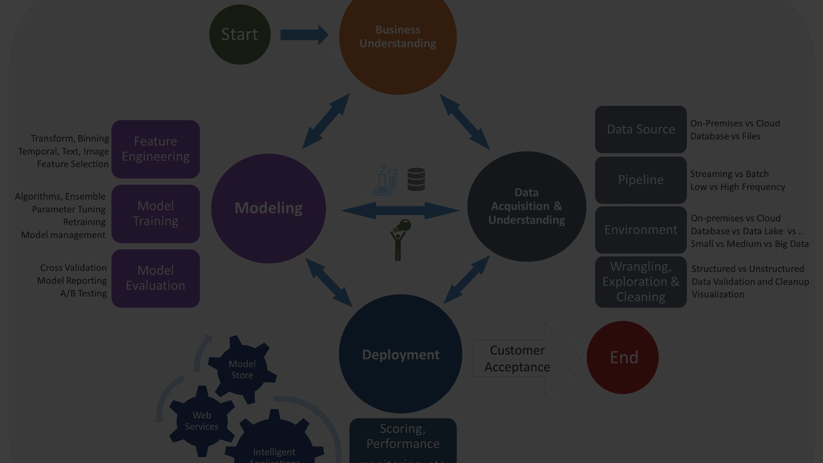
Conclusion
Key Takeaways
Techniques Covered
Right Approach
Proper model evaluation is critical to ensuring effective and generalizable classification models.
Train-test split, cross-validation, stratified cross-validation, and hold-out validation.
Choose the evaluation method that best fits your data, problem, and modeling needs.

